Slide 1




E-WASTE GENERATION CLASSIFICATION

Slide 2

Learning Objectives
Understand the application of AI/ML in e-waste management.
Learn to classify e-waste using EfficientNetV2B0.
Integrate hazard detection and smart sorting using AI pipelines.
Deploy interactive applications using Gradio for real-time testing.
Promote safe, automated e-waste disposal for environmental sustainability.
GOAL
Source :
www.freepik.com/

Slide 3
Tools and Technology used
TECHNOLOGY USED | WHY?
Python 3.11, Jupyter Notebook | For development and testing.
TensorFlow, Keras | For model training and inference.
EfficientNetV2B0 (pre-trained on ImageNet) | For image classification.
Gradio | For creating an interactive user interface.
Matplotlib, Seaborn | For visualizations during analysis.
NumPy | For numerical operations and image handling.

Slide 4
Methodology
Dataset Preparation:
Collected e-waste images, structured into train, test, validation folders.
Categories: Battery, Keyboard, Mobile, PCB, etc.
B. Model Training:
Used EfficientNetV2B0 with transfer learning for classification.
Applied data augmentation to improve generalization.
C. Hazard Detection:
Simulated using a random hazard level generator to enable pipeline integration without additional datasets.
D. Sorting Recommendation:
Based on predicted class and hazard status, recommended appropriate bins (Hazardous, E-Waste, Large Appliance).
E. Deployment:
Created Gradio interface for real-time image upload, classification, and disposal recommendation.

Slide 5
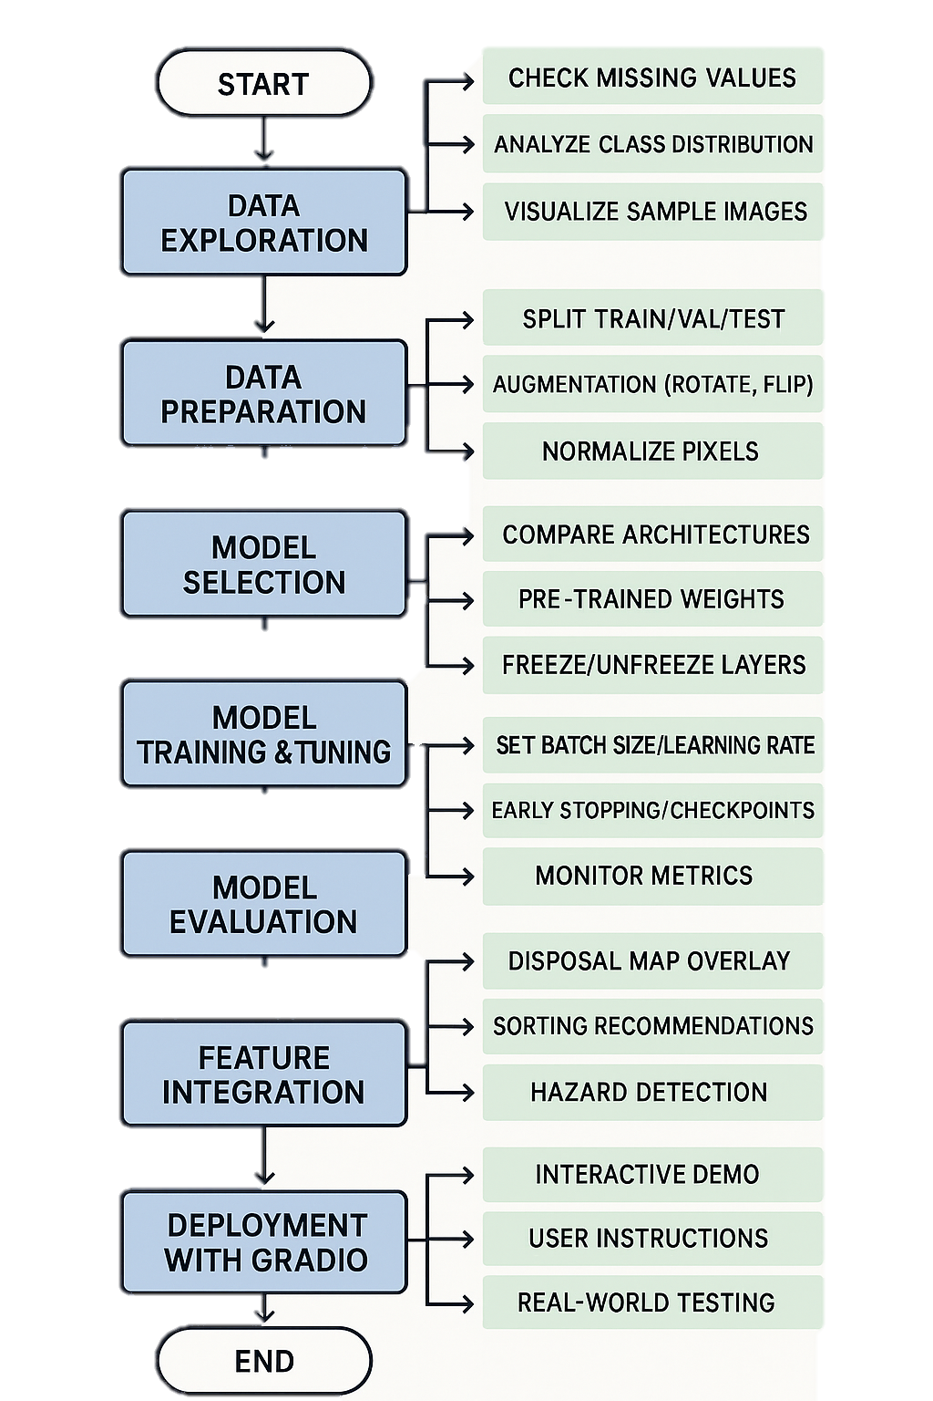
FLOWCHART

Slide 6
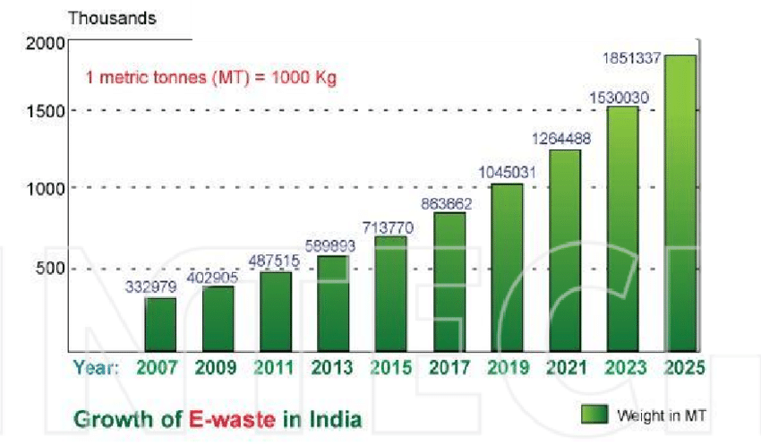
Problem Statement:
WHY THE NEED OF E-WASTE CLASSIFICATION GENERATION?
Electronic waste (e-waste) is a rapidly growing global concern for both environmental and public health. Discarded electronic devices contain both valuable resources and hazardous substances, leading to contamination and health risks if improperly processed. Manual classification for recycling is labor-intensive, prone to errors, and inefficient. This project aims to establish an automated e-waste classification system using artificial intelligence and machine learning, enabling accurate and rapid identification to streamline recycling and promote sustainable waste management.
E-Waste in India
E-waste refers to the discarded electronic and electrical devices that
have reached the end of their lifespan or become obsolete due to rapid technological changes, including computers, phones, TVs, and other equipment.
India ranks as the third-largest producer of electronic waste globally, following China and the United States.
Growth: India’s e-waste increased by 151.03% over six years,
from 7.08 lakh metric tonnes in 2017-18 to 17.78 lakh metric tonnes in
2023-24.

Slide 7

Impact of Improper E-Waste Management
Environmental Degradation:
Water Pollution: Toxic discharge from cyanide and sulphuric acid affects water bodies.
Air Pollution: Emissions from lead fumes and plastic burning are severe.
Soil Contamination: Hazardous substances leach into the soil, damaging agriculture and biodiversity.
Social Costs:
Informal Sector Dominance: 95% of e-waste is recycled informally, involving mostly women and children.
Health Hazards: Average lifespan in informal e-waste workers is under 27 years due to toxic exposure.
Economic Loss:
India is estimated to forfeit over ₹80,000 crore worth of critical metals each year, which could have been recovered and re-used in manufacturing.
It is estimated that India loses at least $20 billion annually in potential tax revenue due to the absence of formal accounting and regulatory oversight in the e-waste recycling sector.

Slide 8
Solution:
Developed an AI-powered smart bin system that :
Classifies e-waste into categories using EfficientNetV2B0.
Simulates hazard detection for safe handling instructions.
Recommends sorting bins automatically for efficient disposal.
Uses Gradio for real-time testing, encouraging easy adoption in practical settings.
GITHUB REPOSITRY LINK : https://github.com/SpadeZ1027/AICTE-Internship/tree/main

Slide 9
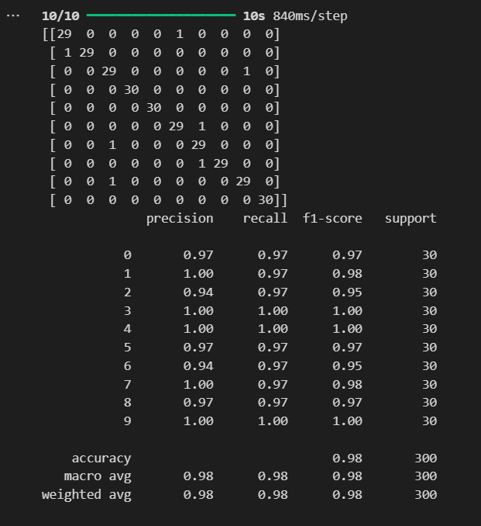
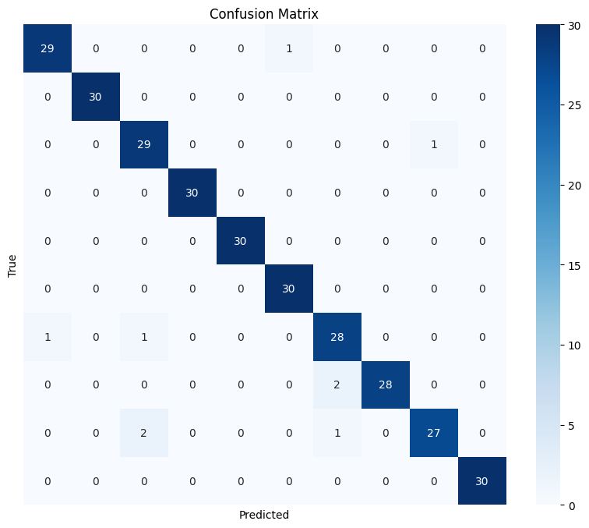
Screenshot of Output:
Confusion Matrix and Classification Report Confusion Matrix as Heatmap

Slide 10
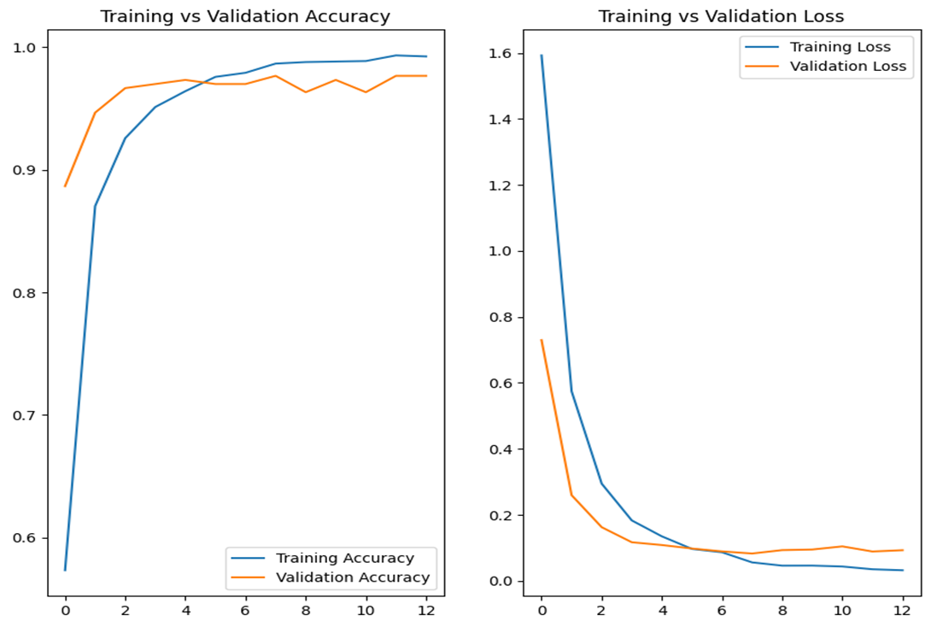
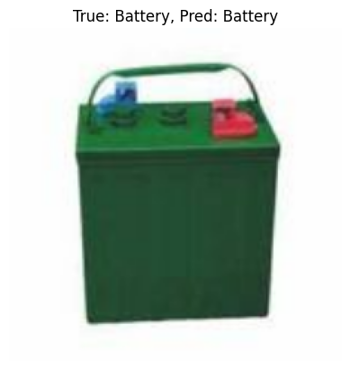
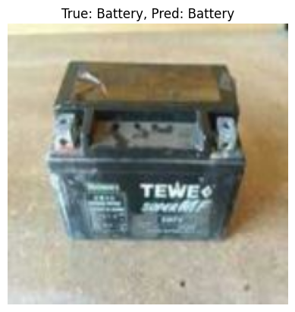
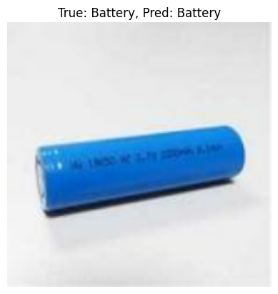
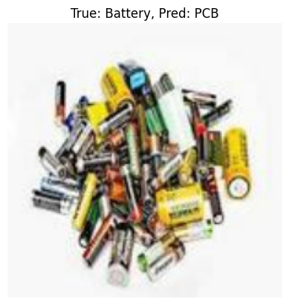
Predicted Test Results

Slide 11
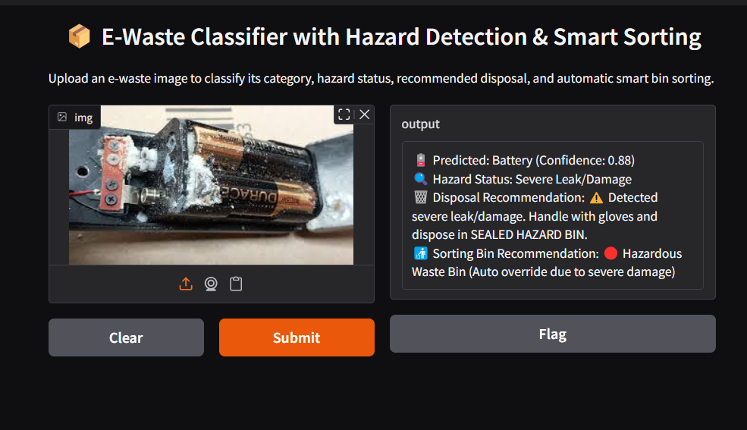
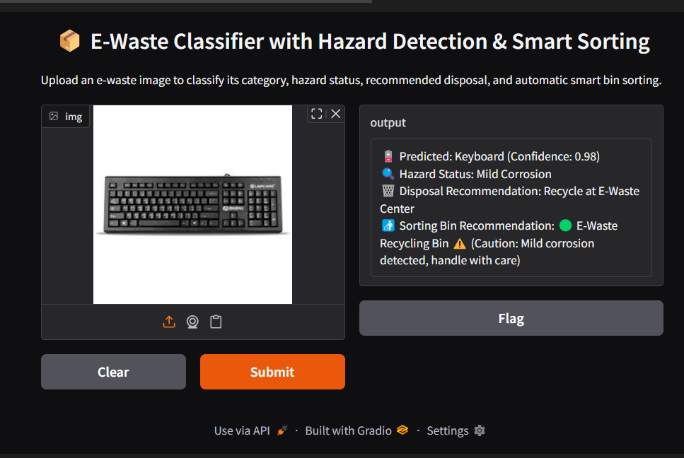
GRADIO INTERFACE DEMO
Running on local URL: http://127.0.0.1:7860
Running on public URL: https://0e76bc6a57d55041f0.gradio.live

Slide 12

Conclusion:
Successfully demonstrated AI integration in sustainable e-waste management.
Enabled safe, efficient, and automated disposal using classification and simulated hazard detection.
Future work can include:
- Real hazard detection using CV datasets.
- Integration with hardware smart bins for automatic sorting.
Project aligns with SDG goals for responsible consumption and environmental protection.

Slide 13

THANK YOU!
Name : Srishti Kaur
Email : srishtikaur2703@gmail.com

